Slide 1

Computer Communications
& Networks
CSNC-2413
Lec: 1,2
Computer Networking: A Top Down Approach
6th edition
Jim Kurose, Keith Ross
Addison-Wesley
March 2012
Introduction
Asma Hanif
Faculty of Information Technology (FIT)
University of Central Punjab (UCP)

Slide 2
Course Intro
Basic course in Computer Networking
Provides overview of…
  What are computer networks
  How do they operate
  How are they designed; (networks & applications)
Adopts TOP DOWN approach…
  Starts with distributed applications designed for networks
  Looks at different layer functionalities required for applications to communicate
  Study relevant networking protocols/standards in wired/wireless domains

Slide 3
Course Contents
Computer Networks & the Internet
  Nuts & Bolts description
  Services description
  Network Edge & Core
  Delay, Loss & Throughput in packet switched networks
  Network architectures (TCP/IP, OSI)
Application Layer
  Network applications principles/architectures
  Services (transport level) available to Apps
  Application layer protocols
  Web/HTTP, FTP, SMTP, POP3, DNS, Peer-to-peer applications
  Apps development; Socket Programming (TCP & UDP)

Slide 4
Course Contents
Transport Layer
  Transport layer in Internet – Multiplexing & de-multiplexing
  Connection less, unreliable transport – UDP
  Principles of Reliable Data Transfer (Go-Back-N, Selective Repeat ARQ)
  Connection oriented transport – TCP
  TCP Connection management, Flow control, Congestion Control
Network Layer
  Network service model, Datagram & VC networks
  Forwarding and routing, What’s inside a router
  IPv4 protocol, Addressing, Subnetting/Supernetting
  IPv6 addressing
  Routing algorithms – LS/DV routing
  NAT, ICMP, RIP, OSPF

Slide 5
Course Contents
Link Layer
  Link layer functions
  Multiple access protocols
  Link layer addressing
  Link layer Technologies
    Ethernet - IEEE 802.3 standard

Slide 6
Course Contents
Network Programming :
  Socket Programming
    Client/Server communications paradigm
    TCP & UDP client-server comm
    Iterative & Concurrent servers
    Unix network programming in ‘C’
      Socket API

Slide 7


Books Recommended
Text:
Computer Networking: A Top-Down Approach (6th Ed)
  by James F. Kurose & Keith W. Ross
Unix Network Programming – Vol I
  by W Richards Stevens
Ref:
Computer Networking: A Systems Approach (5th Ed)
  by Larry L. Peterson & Bruce S. Davie

Slide 8
Course Methodology
Lectures
30 power point lectures
Study relevant sections of Text/Ref books
Exam Pattern
Exams to include complete material in covered chapters
MCQs, short answers, problems, design/analysis questions

Slide 9
Grading Policy
Quizzes ………. 08 15%
Assignments ……… . 04 15%
Mid-Term ..….…. 30%
Final .……… 40%
Distribution is tentative and flexible

Slide 10
Lets Start the Course…

Slide 11
Chapter 1: Introduction
our goal:
get “feel” and terminology
more depth/detail later in course
approach:
  use Internet as example
overview:
What is the Internet?
What is a network protocol?
Network Edge: hosts, access net, physical media
Network Core: packet/circuit switching, Internet structure
Performance: loss, delay, throughput
protocol layers, service models

Slide 12
Chapter 1: roadmap
  1.1 what is the Internet?
  1.2 network edge
    end systems, access networks, links
  1.3 network core
    packet switching, circuit switching, network structure
  1.4 delay, loss, throughput in networks
  1.5 protocol layers, service models
  1.6 networks under attack: security
  1.7 history

Slide 13


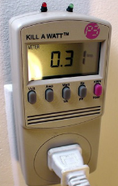



“Fun” Internet appliances
Web-enabled toaster +
weather forecaster
IP picture frame
http://www.ceiva.com/
Tweet-a-watt:
monitor energy use
Slingbox: watch,
control cable TV remotely
Internet
refrigerator
Internet phones

Slide 14




















What is the Internet: “Nuts & Bolts” view
Basic components that make up the Internet; H/W & S/W
mobile network
computing devices:
(millions are connected)
  hosts, end systems
  run network apps
PC
server
global ISP
wireless
laptop
smartphone
home
network
communication links:
  copper, fiber,
  radio, satellite
  transmission rate: bandwidth
regional ISP
wireless
links
wired
links
Packet switches:
forward packets (chunks of data)
  switches & routers
router
institutional
network

Slide 15
What’s the Internet: “Nuts & Bolts” view
Internet: “network of networks”
  hierarchical structure
  interconnected ISPs
  (lower tier ISPs, upper tier ISPs, …)
N/W comm thru “protocols”
  run at end systems & switches
  control sending/receiving of msgs
  e.g, HTTP, Skype, TCP, IP, 802.11
Internet standards
  IETF: Internet Engineering Task Force
  RFC: Request for comments
mobile network
global ISP
home
network
regional ISP
institutional
network

Slide 16
What’s the Internet: Services view
Infrastructure that provides services to applications
  Apps… Web, Email, VoIP, E-commerce, Internet TV/radio, audio/video on demand, video conf, online games, social nets, …
  Distributed Apps… involve multiple end systems that exchange data…
  Different Types of Services… reliable or “best effort” (unreliable) data delivery, thruput/delay needs, security, …
  How do Apps obtain services from network…???
mobile network
global ISP
home
network
regional ISP
institutional
network

Slide 17
What’s the Internet: Services view
End System provides an interface to apps
  Network API
  “Functions” that allow process on source end system to…
    “connect” to Internet
    “send/recv” data to app on dest end system
  Specifies syntax of how an app
  asks Internet to “deliver data”
  provides options for various types of services …
mobile network
global ISP
home
network
regional ISP
institutional
network

Slide 18



What’s a protocol?
An important buzzword in computer networking… “Protocol“
“pre-defined set of rules”
Analogy… Human protocol & Computer Network protocol…
Hi
TCP connection
request
Hi
TCP connection
response
Got the
time?
Get http://www.awl.com/kurose-ross
2:00
<file>
time

Slide 19
Network protocols?
Network protocols:
machines rather than humans… need coordination
all communication activity in Internet governed by protocols…
  specific msgs sent
  specific actions taken
  when msgs received, or other events
Network protocols define…
format/order of msgs
sent/received among
network entities,
&
actions taken
on msg Tx/Rx

Slide 20
Chapter 1: roadmap
  1.1 what is the Internet?
  1.2 network edge
    end systems, access networks, links
  1.3 network core
    packet switching, circuit switching, network structure
  1.4 delay, loss, throughput in networks
  1.5 protocol layers, service models
  1.6 networks under attack: security
  1.7 history

Slide 21

Network Structure
network edge:
  end systems
    hosts & applications
  access networks
    networks that connect end
    system to edge router
    wired/wireless communication
    links
mobile network
global ISP
home
network
regional ISP
network core:
  interconnection of routers
  routes pkts from src to dst
  forms network of networks
institutional
network

Slide 22
The network edge
End systems (hosts):
  host (run) application programs
  e.g, Web, email
Client/server model:
  hosts act as client or server
  server – always on powerful machine
  client – requests/receives service
  e.g, Web browser/server; email client/server
Peer-peer model:
  all hosts equal
  minimal (or no) use of dedicated servers
  e.g, Skype, BitTorrent, Gnutella

Slide 23
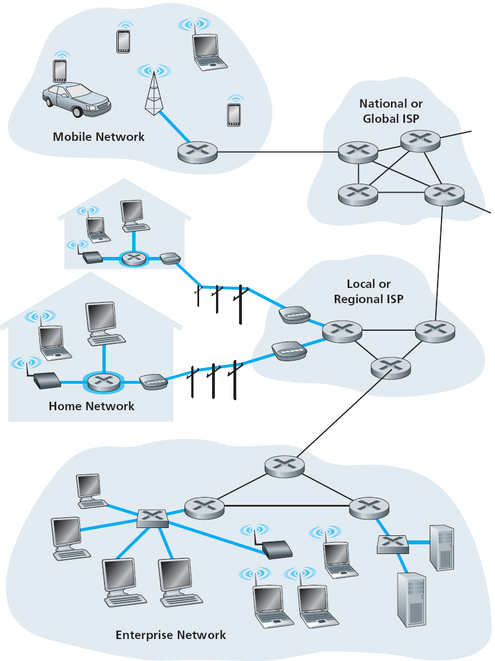
Access networks
Networks to connect end systems to edge router
Several types of access networks used in various settings…
  home access
  enterprise access
  wireless access
keep in mind…
bandwidth (bits per second) of access network ?
shared/dedicated access ?

Slide 24
Home Access
How homes connect to Internet
Digital Subscriber Line (DSL)
Cable Internet access
Fiber-to-the-Home (FTTH)
Dial up modem
Two most prevalent ones are
DSL & Cable

Slide 25
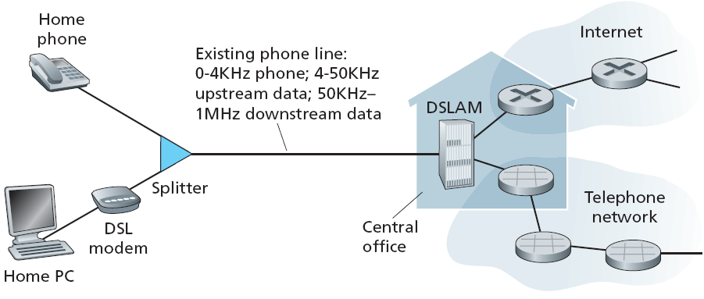
Access net: Digital subscriber line (DSL)
  Use existing telephone line to central office DSLAM for Internet access
    telco is also the ISP
    dedicated line to ISP
    data & voice signals on same line at different freq
    splitter & DSLAM separate data/voice signals
    data over DSL line goes to Internet; voice goes to telephone net

Slide 26
Access net: DSL
  DSL provides asymmetric access
  Typical transmission rates
    downstream 1 to 2 Mbps; upstream 128 kbps to 1 Mbps
  VDSL has higher transmission rates
    downstream 12 to 55 Mbps; upstream 1.6 Mbps to 20 Mbps
  actual rate depends on link distance, wire gauge & elec interference

Slide 27
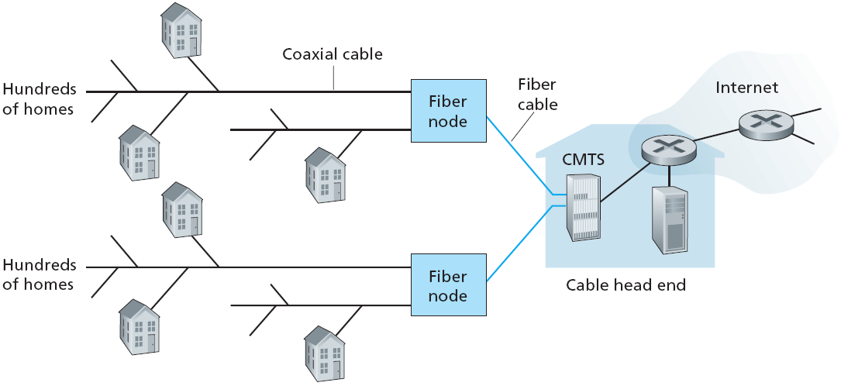
Access net: Cable network
Junction
  Use existing cable TV network for Internet access…
    cable TV provider is also the ISP
    data & video signals on same cable at different freq
    fiber connects cable head end to neighborhood junctions
    coaxial provides further connection to homes
    require cable modems & cable modem termination system (CMTS)

Slide 28
Access net: Cable network
HFC: hybrid fiber-coax
  Network of fiber/coax cable attaches homes to ISP router
shared broadcast medium; homes share access network to ISP
  bandwidth gets divided between users
  file download vs web surfing…
  distributed multiple access protocol needed to coordinate Tx
access is asymmetric
  up to 30 Mbps downstream, 2 Mbps upstream

Slide 29
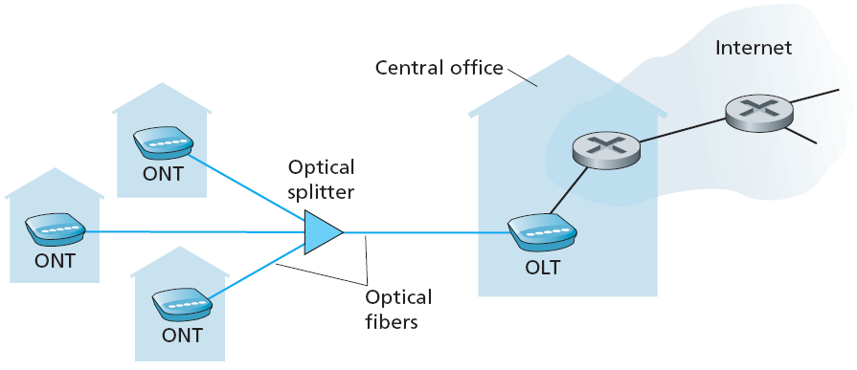
Access net: FTTH
  Optical fiber path from telco CO to home
    significantly higher Tx rates (1 Gbps)
    Internet access, telephone & video services
  Technologies for optical distribution…
    Direct Fiber : one fiber from CO to home
    Passive Optical Network (PON) : shared fiber
    Active Optical Network (AON) : like switched Ethernet (study later)

Slide 30
Access net: FTTH
  PON Architecture
  ONT (optical network terminator) connects home to neighborhood splitter
  Splitter combines signals on a shared fiber and connects to OLT
  (optical line terminator) at CO
  OLT provides electro/optical conversion, & connects to Internet via telco router
  Home Router attached to ONT, allows users access to Internet

Slide 31





Home access networks
wireless
devices
to/from headend or central office
often combined
in single box
Cable/ DSL modem or ONT
wireless access
point (54 Mbps)
router, firewall, NAT
wired Ethernet (100 Mbps)

Slide 32
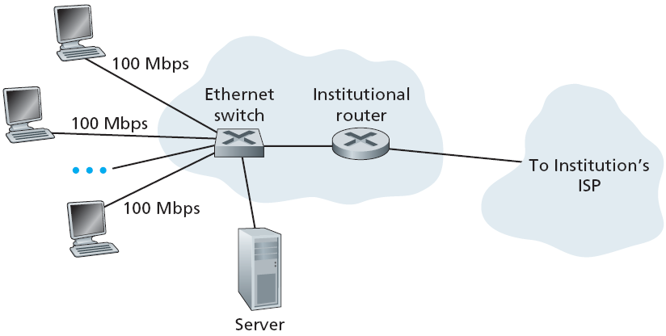
Enterprise access networks (Ethernet)
LAN used to connect end systems to edge router
Ethernet : most prevalent access technology
  uses twisted pair copper wire & switches
  typically 100 Mbps to end systems, & 1 to10 Gbps to servers

Slide 33








Wireless access networks
Shared wireless access network connects end system to edge router
  via “access point”or base station
Wide-area Wireless access
  provided by telco (cellular) operator
  range 10’s of kms
  data rate 1 & 10 Mbps
  3G, 4G, LTE,….
  WiMAX
Wireless LANs:
  within building (100 ft)
  802.11b/g (WiFi): 11, 54 Mbps transmission rate
to Internet
to Internet

Slide 34

Physical media: Copper
Physical medium: what lies between transmitter & receiver
carries bits - propagation of electromagnetic waves or optical pulses across physical medium
Guided media
  signals propagate in solid media
  e.g, copper, fiber, coax
Unguided media
  signals propagate freely
  atmosphere, outer-space
Twisted pair (TP)
two insulated copper wires, in spiral pattern
  Category 5: 100Mbps, 1Gpbs Ethernet
  Category 6: 10Gbps

Slide 35


Physical media: Coax, fiber
Coaxial cable:
two concentric copper conductors, with shielding
bidirectional signal flow
shared medium
end systems connected directly
high bit rates, broadband
multiple channels on cable
Fiber optic cable:
glass fiber carrying light pulses,
each pulse a bit
carry tremendous bit rates
  e.g, 10 – 100 Gpbs
long haul Tx media
low error rate:
  immune to electromagnetic noise
  repeaters spaced far apart

Slide 36
Physical media: Radio
Radio Links
Carry signals in electro- magnetic spectrum
Charateristics…
  no physical “wire”
  bidirectional
  penetrate walls
  support mobility
Propagation environment effects…
  reflection
  obstruction by objects
  interference
Radio link types
Local Area
  wireless LAN (e.g, WiFi)
  11Mbps, 54 Mbps
Wide Area (e.g, cellular)
  3G/4G cellular: in Mbps
Satellite
  link two ground stations
  geostationary vs low earth orb (LEO)
  upto 100s of Mbps speed
  upto 280 msec end-end delay

Slide 37
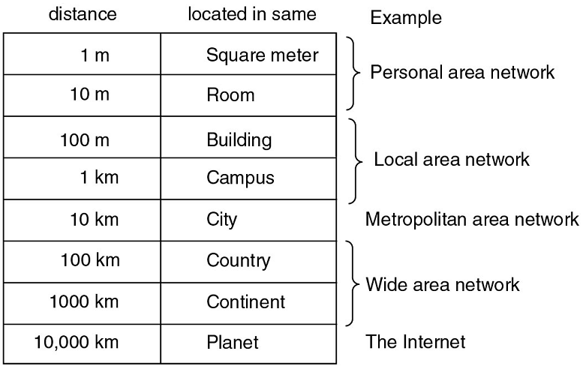
Network Categorization
Networks categorized based on their area of coverage:
  Personal Area Network
  (PAN)
  Local Area Network
  (LAN)
  Metropolitan Area Network
  (MAN)
  Wide Area Network
  (WAN)
also body area network, sensor network,
vehicular network

Slide 38
Summary
  1.1 what is the Internet?
  1.2 network edge
    end systems, access networks, links
  1.3 network core
    packet switching, circuit switching, network structure
  1.4 delay, loss, throughput in networks
  1.5 protocol layers, service models
  1.6 networks under attack: security
  1.7 history

